Slide 1

Applying Systematic Risk Management Protocol to the Design of a Modern Propellant Manufacturing Plant in Australia Bob Ford
rford@smsenergetics.com
www.smsenergetics.com
August 2018

Slide 2
Presentation Outline
Mulwala Redevelopment Project (MRP) introduction
SMS Approach:
Systematic Risk Assessment
In-Process Characterization & Classification Testing
Applying Test Data to Minimize Risk
Summary

Slide 3
MRP Introduction

Slide 4

Mulwala Redevelopment Project (MRP) - ADoD

Slide 5




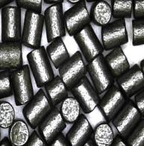
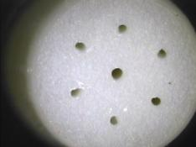
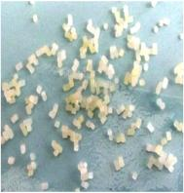
Mulwala Redevelopment Project
An Australian Department of Defence contract to design, construct, commission, and qualify a 530 tonnes per year single-base propellant process plant. Upgrading the munitions factory that was built in the 1940’s to support World War II.
556 Ball Propellant
556 Blank Propellant
.50 Cal Ball Propellant
BS-NACO Propellant
25mm Propellant

Slide 6



MRP Team
Lend Lease – Prime
ATK – Technology Provider
SMS – 3rd Party Explosives Safety

Slide 7
MRP Requirements
Improved Safety
Modern/Enhanced Propellant Manufacturing
No Possibility of 1.1 Events
1.3 Maximum Potential Event
Continued Propellant Production during Construction
Regulatory Compliance during and after MRP Construction

Slide 8
MRP Team: Risk Management Philosophy
“Safety by Design”
Minimize Personnel Exposure
Minimize Quantities of Hazardous Materials
Safety Specifications
Standards
Procedures
Training

Slide 9
SMS Stewardships
Systematic Risk Assessment
Explosives In-Process Characterization & Classification Testing
Facility Siting
Site Plans
Concurrent Operations
Facility Design Specifications
Barricade Design
Workstation Protection
Regulatory Compliance
Explosives Test Equipment
Training

Slide 10
Relationship of Risk Assessment to Proper Classification of Explosives
Facility:
Site Plan
Concurrent Operations
Facility Design
Barricades
Process
Equipment Design
Control System Design
Attended vs. Remote
Risk Acceptance
Explosives Classification
Explosives Characterization Tests
Key Parameters:
Composition
Physical State
Configuration/Confinement
Conditions
Risk Assessment

Slide 11
SMS Approach:
Systematic Risk Assessment
In-Process Characterization & Classification Testing
Applying Test Data to Minimize Risk

Slide 12
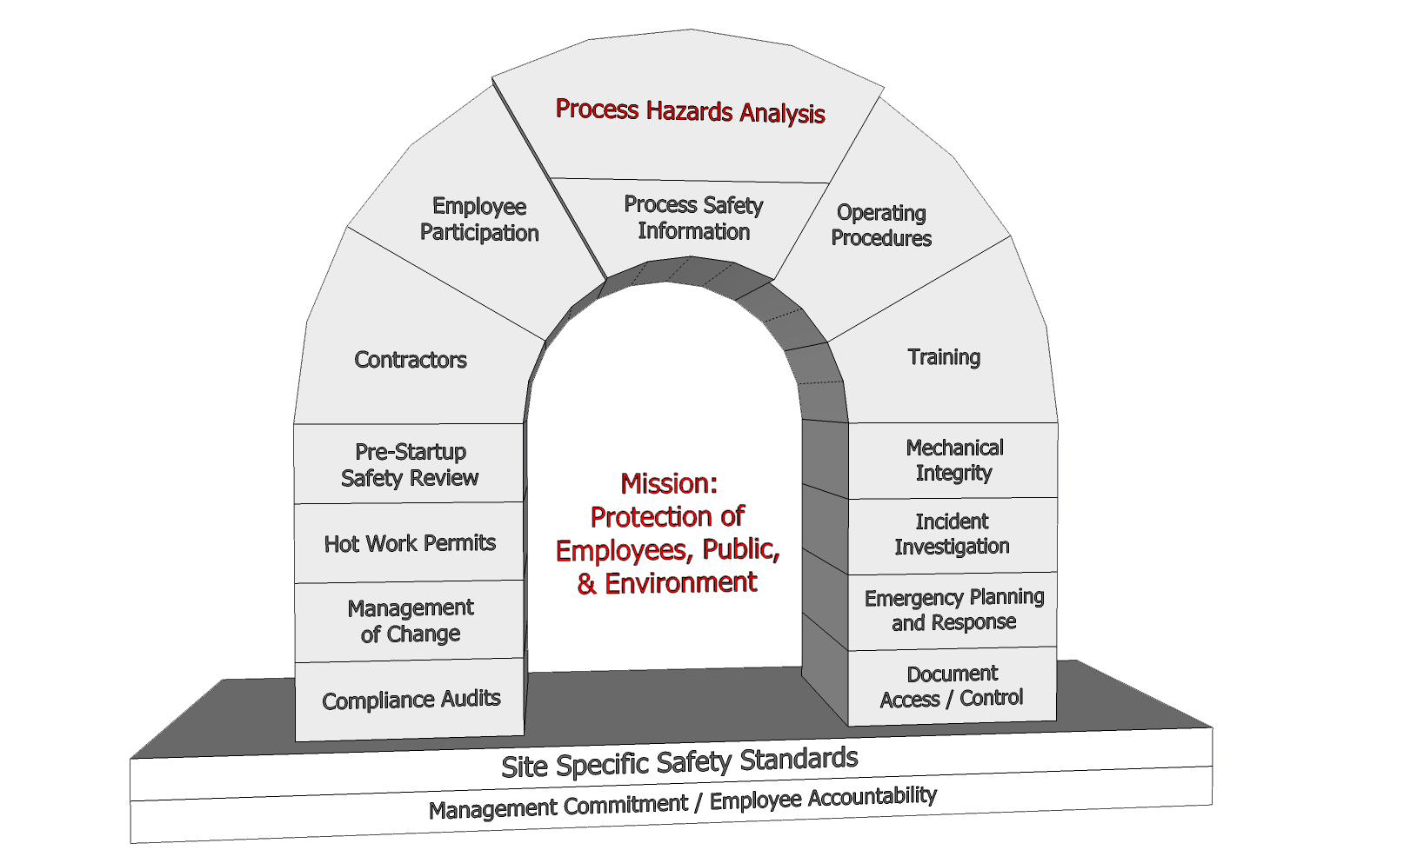
Elements of a Successful Risk Management Program

Slide 13
What Creates the Need for Systematic Risk Assessment and “In-Process” Characterization/Classification?
Simple to Complex Systems/Processes
Multitude of potential scenarios
Variations in energetic material
Compositions
Physical States
System insult energies (normal & abnormal)
Variable process configurations and confinement

Slide 14
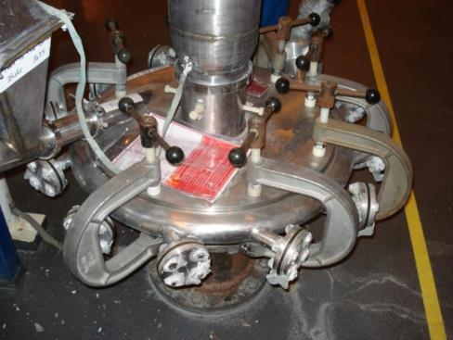
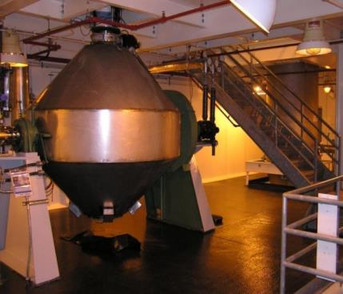
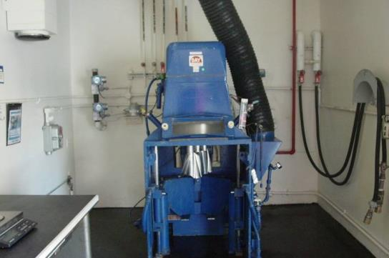
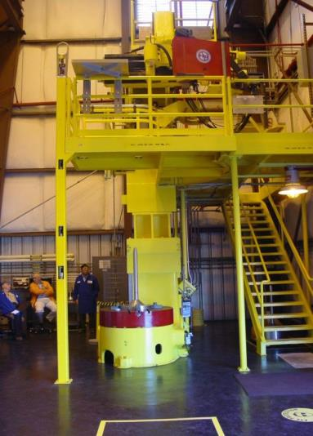
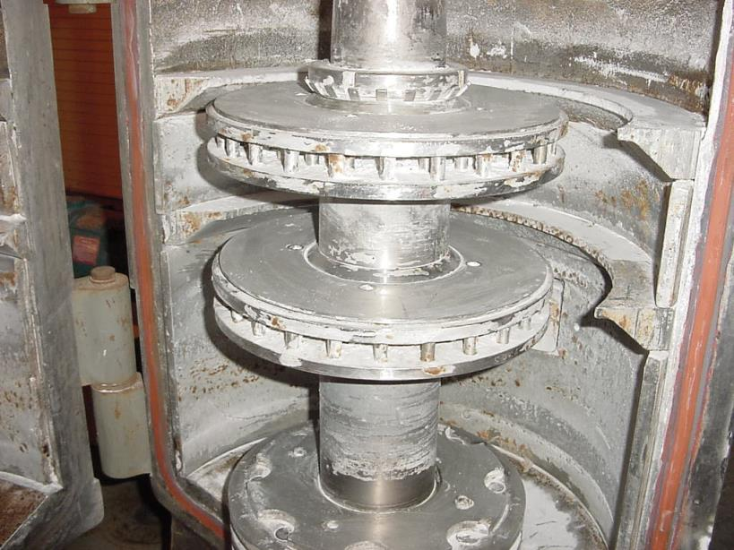
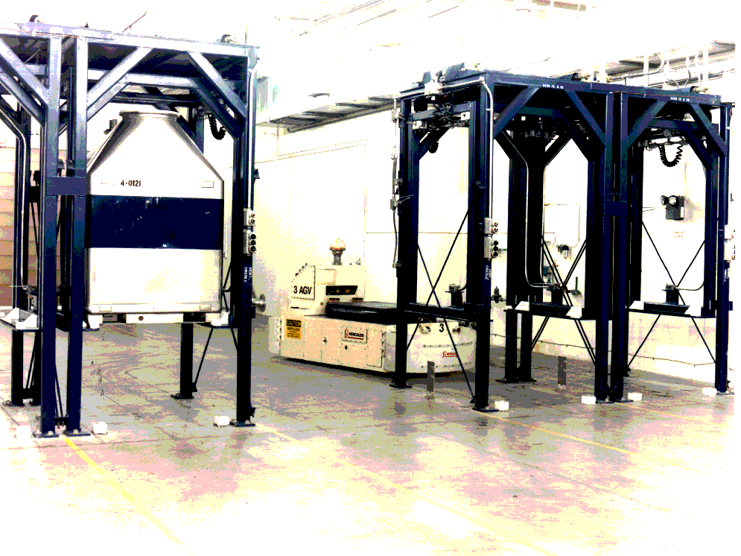
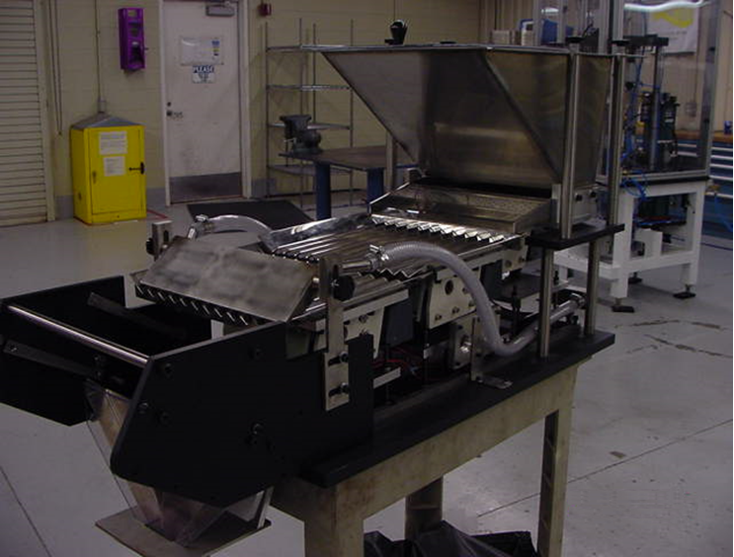
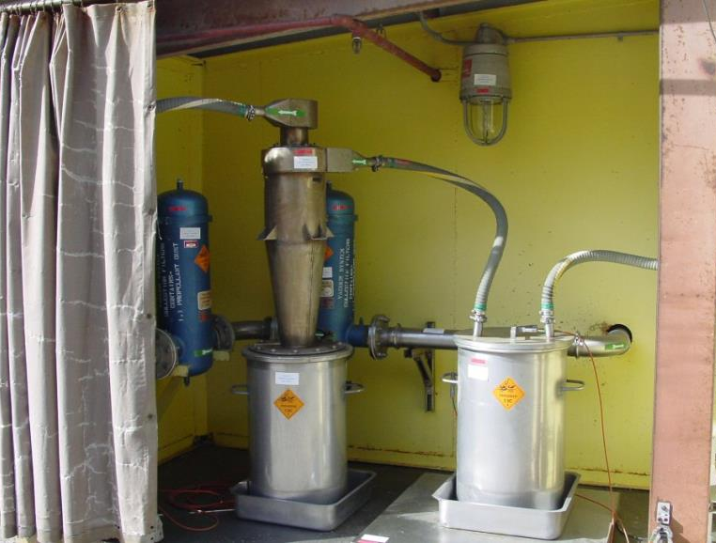
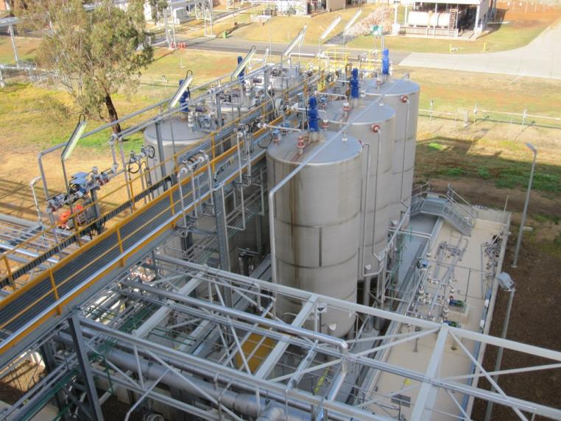
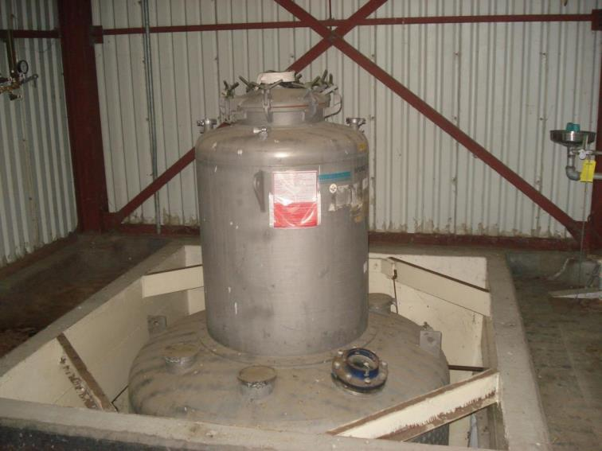
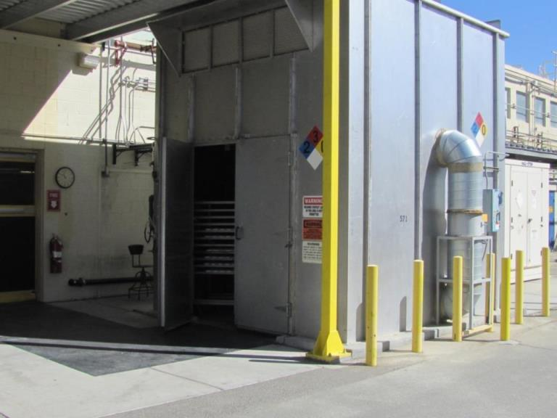
Processes and Unique Hazards

Slide 15
Key Parameters for Explosives
 | Manufacturing | Storage | Transport | Use
Composition | Variable | Constant/ Variable | Constant | Constant/ Variable
Physical State | Variable | Constant | Constant | Constant/ Variable
Configuration/ Confinement | Variable | Constant/ Variable | Constant | Variable
Quantity | Variable | Constant/ Variable | Constant | Variable
Conditions | Variable | Variable (Bounded) | Variable (Bounded) | Variable
Initiation Stimulus | Variable | Variable (Bounded) | Variable (Bounded) | Variable

Slide 16
Life Cycle Stages of Explosives
Configured for Transport
7
General Industry
Use/Application
Research & Development
1
Removed from
Transport Configuration
8
Processing
Display/Access
2
Manufacturing
Processing/
Operations
9
General Industry
Warehouse/Stock Room
6
3
4
Transport
10
Intermediate Storage
Storage
(Configured for Transport)
Explosive Industry Magazine
11
Service Magazine
5
Remanufacturing
13
12
Explosive Industry
Use/Application
Waste, Reuse, or Recycling

Slide 17
Explosives Risk Assessment
Organize by Operational Steps
OR Process Equipment
Insult Energies
Determined by
Measuring
Calculating
Modeling
Identify Potential Hazards Based on
Normal and Abnormal Events and Causes
Insult Energies
Configurations
Conditions
Key for MRP
Perform Explosives Testing
that Simulates In-Process:
Insult Energies
Configurations
Conditions
Test Data in
Energy Units
Existing
Safeguards
Evaluate/Assess Risk
Qualitative
Quantitative
Recommend Risk Mitigating Measures
Equipment Specifications
Operating Parameters
Facility Design/Shielding
Etc.

Slide 18
SMS Approach:
Systematic Risk Assessment
In-Process Characterization & Classification Testing
Applying Test Data to Minimize Risk

Slide 19
MRP Application of “In-Process” Characterization & Classification Tests
Sensitivity Testing
Friction Sensitivity Test
Impact Sensitivity Test
ESD Sensitivity Test
Thermal Tests (SBAT)
Reactivity Testing
Critical Height
No. 8 Cap Sensitivity Test
NOL Card Gap Test
Small Scale Burn
etc.
Subscale, Bench-scale and full-scale simulation tests

Slide 20
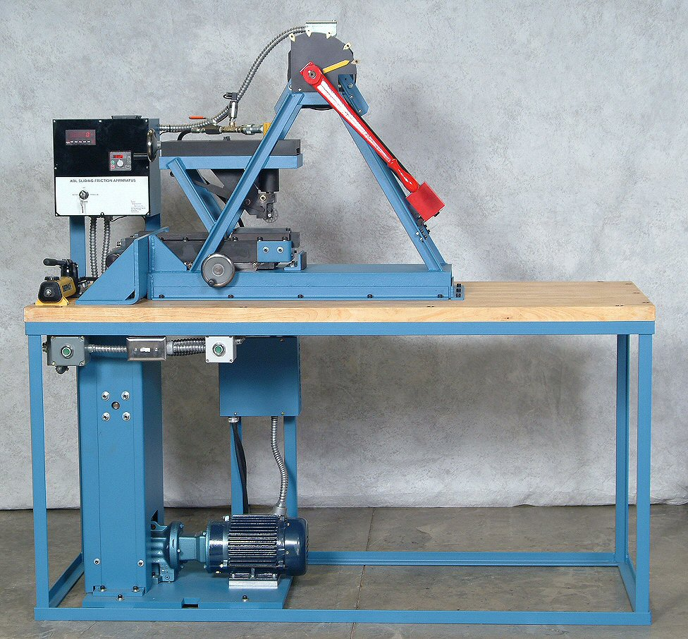
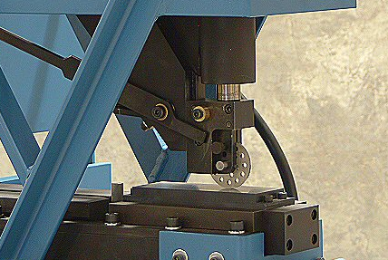
Friction Sensitivity Test (ABL)
^{Force/area}
^{@ velocity}
Units: N/m²

Slide 21
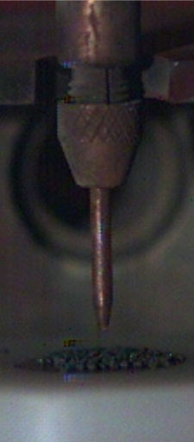
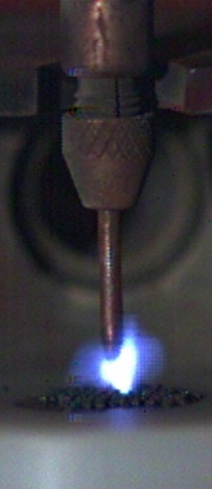

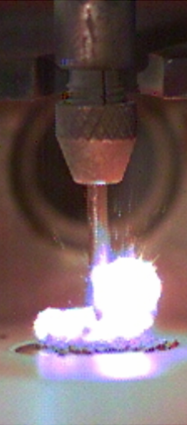
ESD Sensitivity Test (ABL)
E=½CV²
E=½QV
Units: Joules

Slide 22
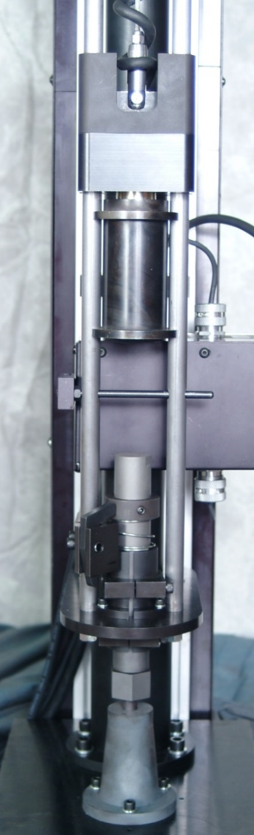
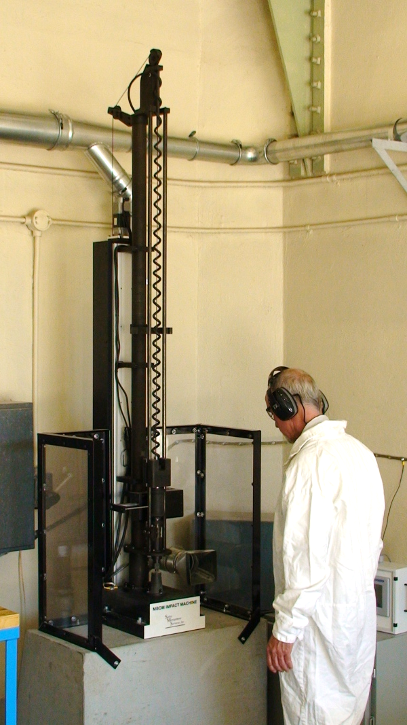
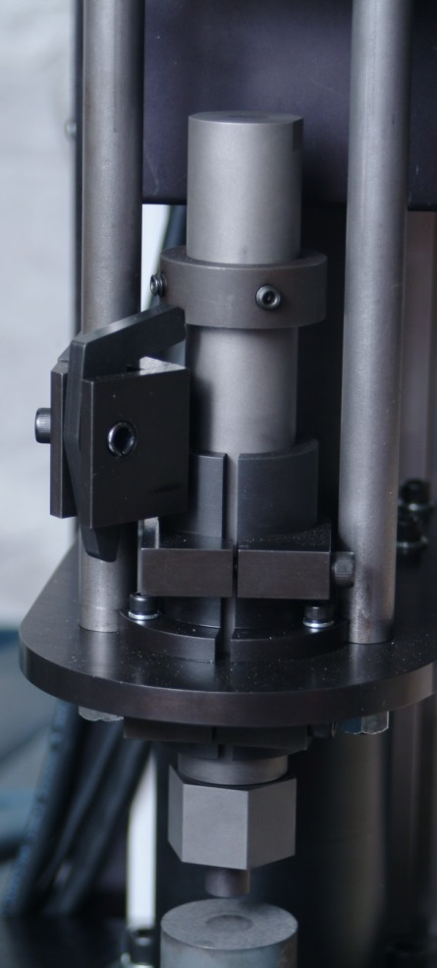
Impact Sensitivity Test (MBOM)
Energy/Area
Units: J/m²

Slide 23
Log Logistic Regression Plot (Characteristic Curve)

Slide 24
In-Process Energies verses Material Response Data
Increasing Energy Level
Probability
Range of In-Process Energies
Range of Energetic Material Response

Slide 25
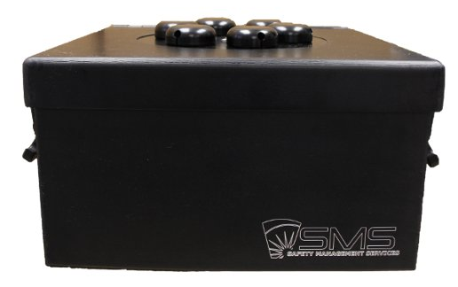
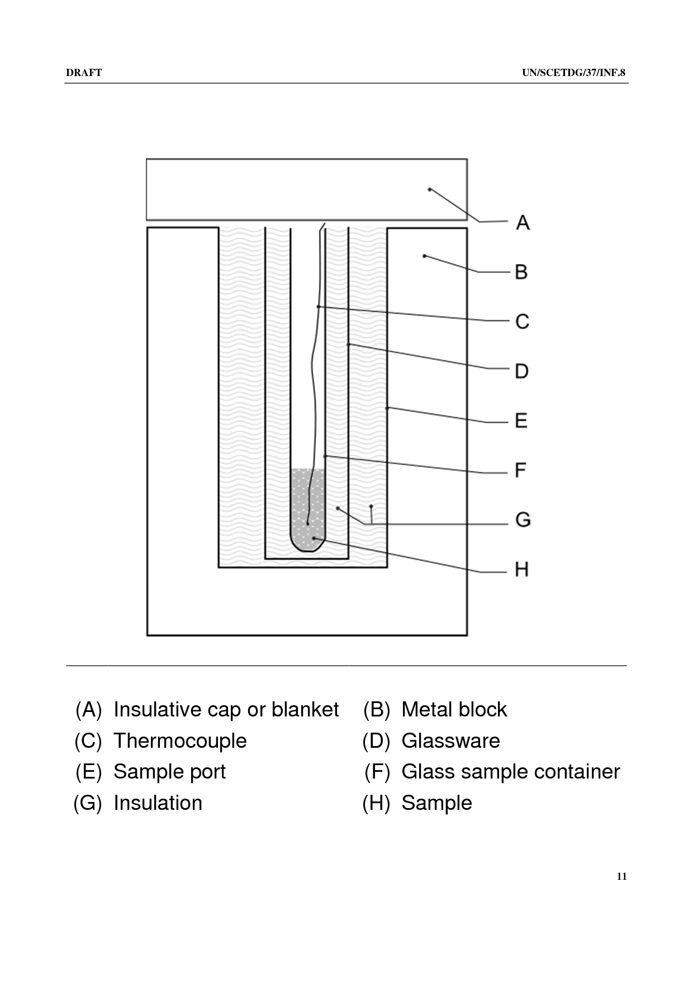
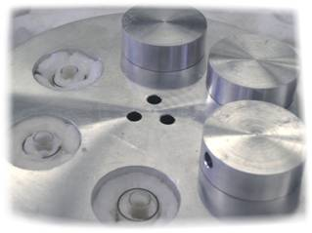
Thermal Sensitivity Test (SBAT) Simulated Bulk Auto-ignition Temperature

Slide 26
SBAT Applications
Determination of conservative auto-ignition temperature (bulk AIT value)
Determination of time to ignition at temperatures below AIT (isothermal run mode)
Conservative compatibility testing
Thermal Stability Testing
Safe: Minimized exposure)
Complete vacuum thermal stability (with upgrade)
Notes:
Talk about scale-up

Slide 27
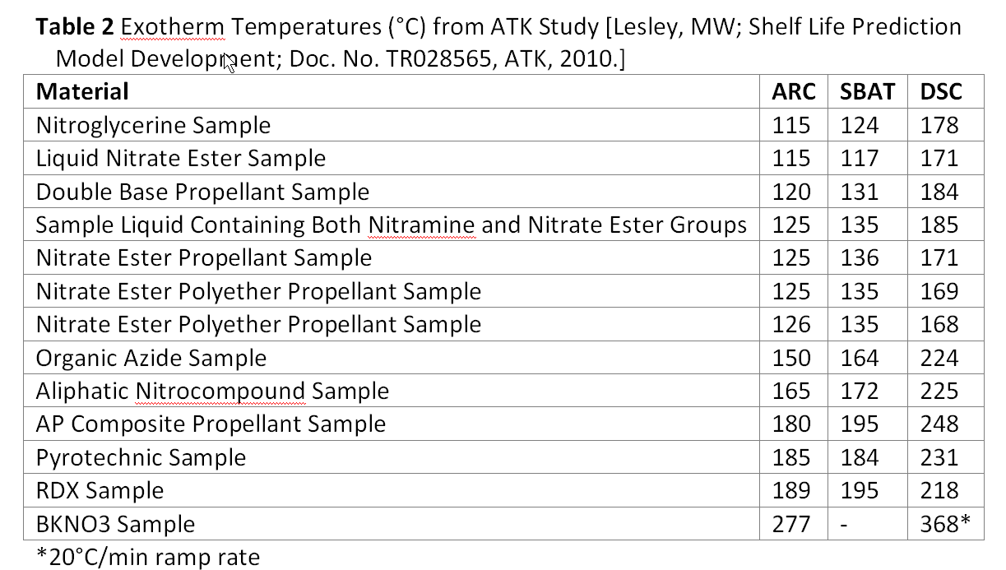
DSC, SBAT, and ARC AIT Temperatures
Notes:
Note: the temperature at which the SBAT exotherm is reported is when the temperature deviated by greater than 1.1°C above the baseline; the DSC temperature reported is the onset temperature (point of intersection of a line drawn tangent to the steepest slope of the curve with the baseline). The ARC temperatures were determined using a “heat-wait-search” scheme while heating at an approximate rate of 0.1°C/min. The DSC and SBAT samples were heated at a constant 10°C/min and 0.22°C/min, respectively. Average deviation from ARC for SBAT and DSC is +8.6°C and +57°C respectively.

Slide 28
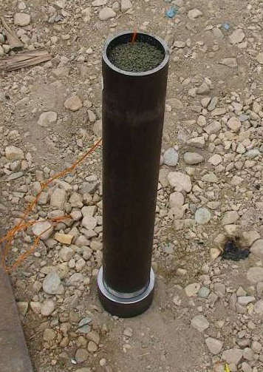
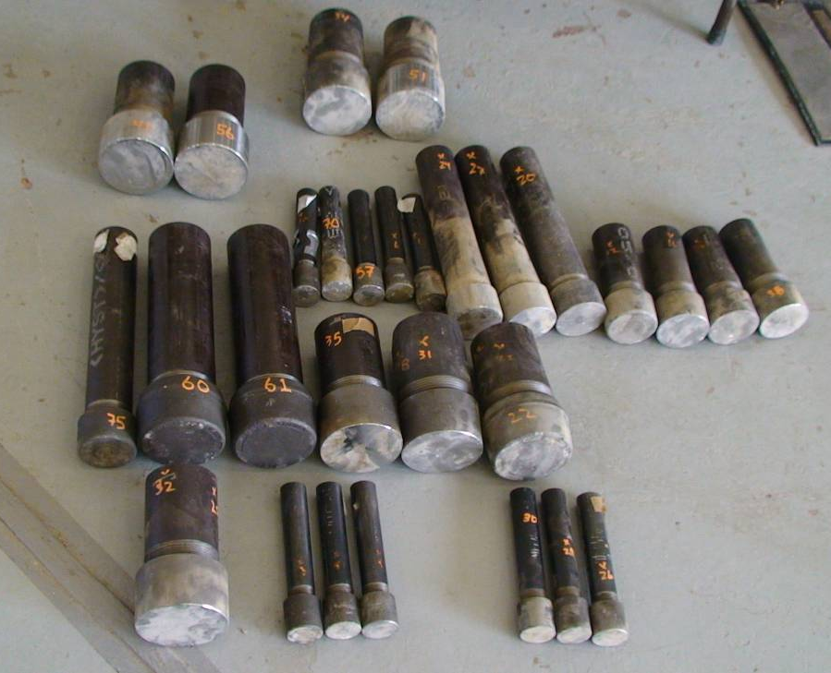
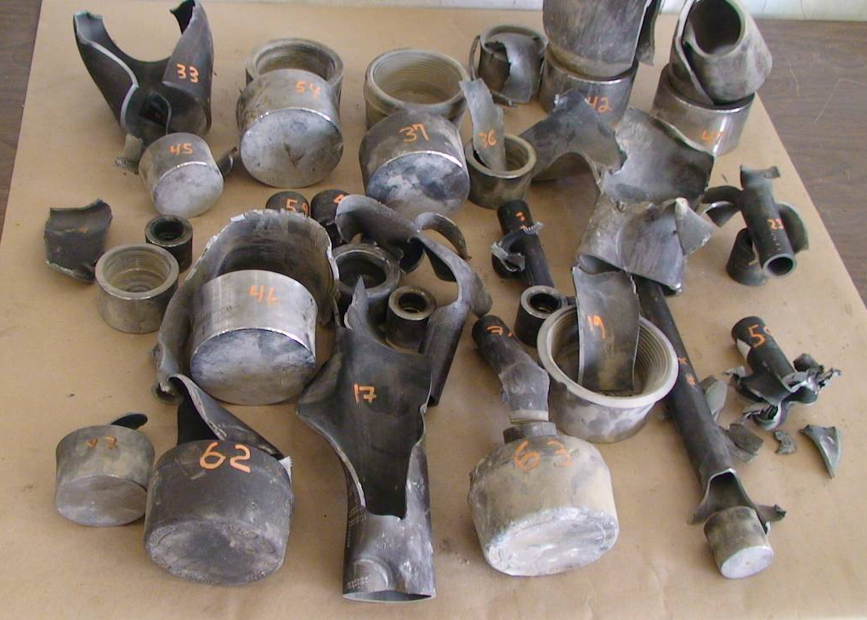
Critical Height Testing
Fastest burning Propellants tested
Worst case geometry determined to be a 1 to 1 ratio of diameter to height

Slide 29
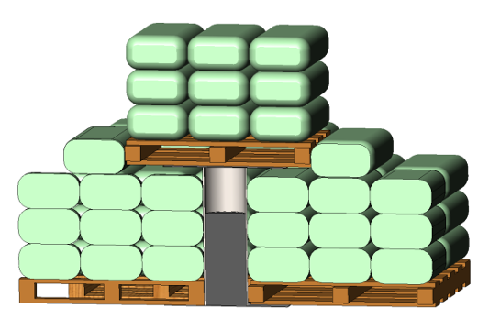
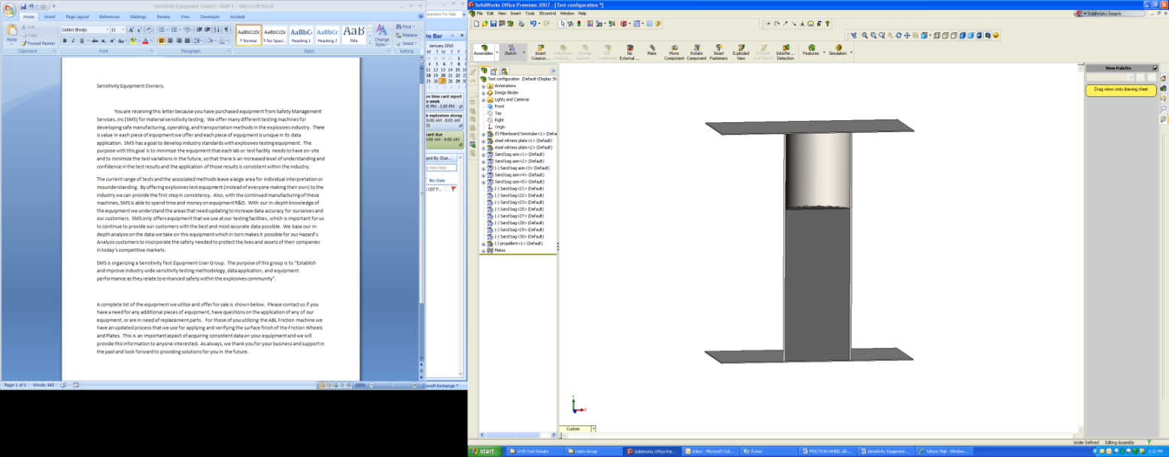
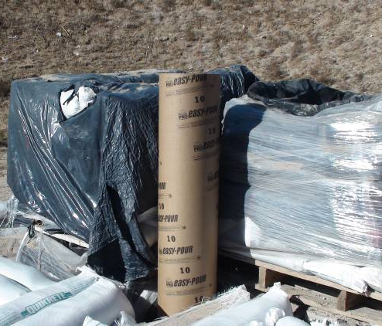
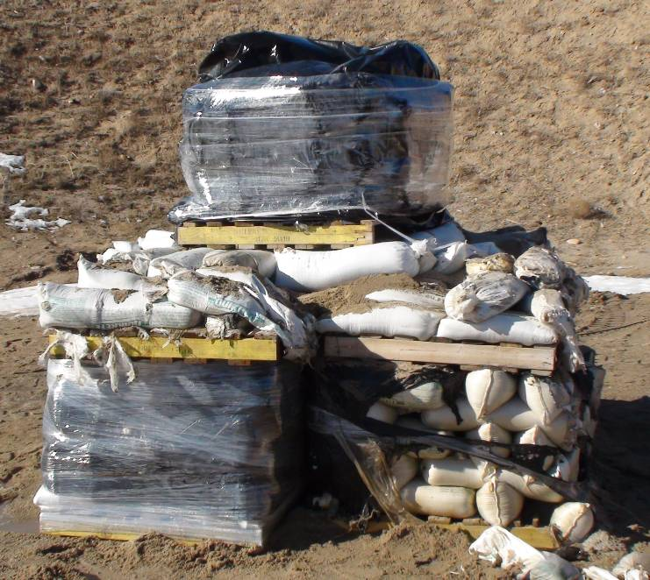
Bulk Confined Sonotube™ Testing
Bulk Confined Sonotube™ testing
Excess confinement of bulk propellant
Larger Scale Critical Height
Surrounded by Sand bags 295kg per pallet
254mm diameter (10in) (concrete forming tube)
Limit: 700mm bed depth & 600mm head space
In Process Applications
Validation of small scale critical height results
Ribbon blender
Propellant Dryer
Feed hoppers
Bulk bag configuration in storage magazines
Storage and transport containers

Slide 30
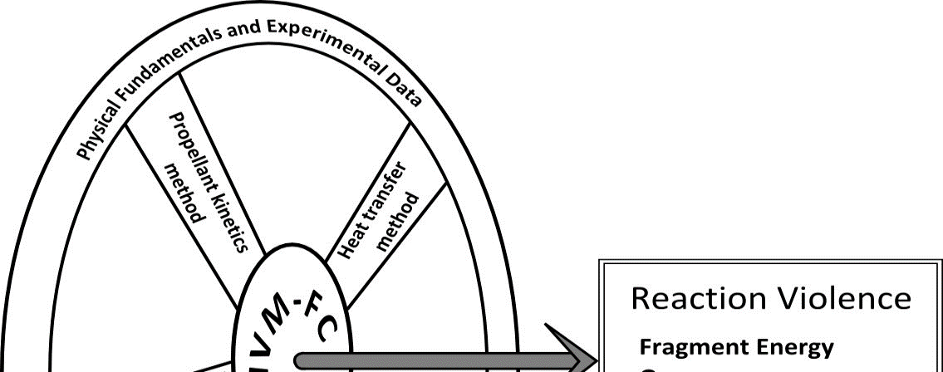
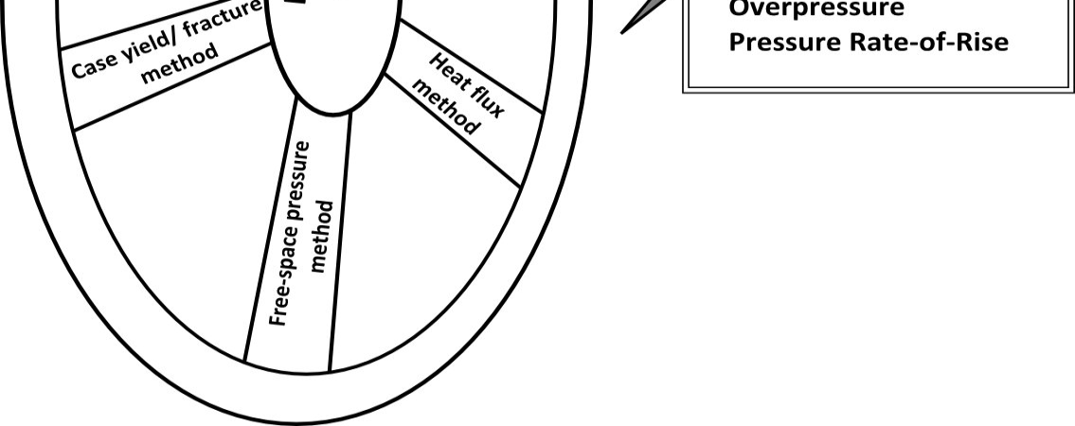
Process Simulation Modeling
Blast Modeling on select equipment using Integrated Violence Model (IVM)
Inputs to model: characteristics determined by testing of propellants
Verification of designs
Dryer
Ribbon blender

Slide 31
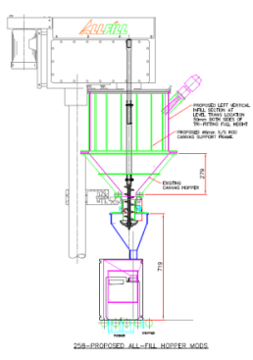
Process Example Propellant Feeder
Safeguards based on test data
Steel hopper changed to a venting canvass hopper due to confinement
Steel parts such as screw, chute and discharge disk changed to a plastic due to friction and impact stimulus
Plastics tested to ensure ESD within safe limits
Max fill of a 1:1 ratio of diameter to height (critical height) with additional level controls & interlock
Speed of screw limited to reduce friction and impact stimulus

Slide 32
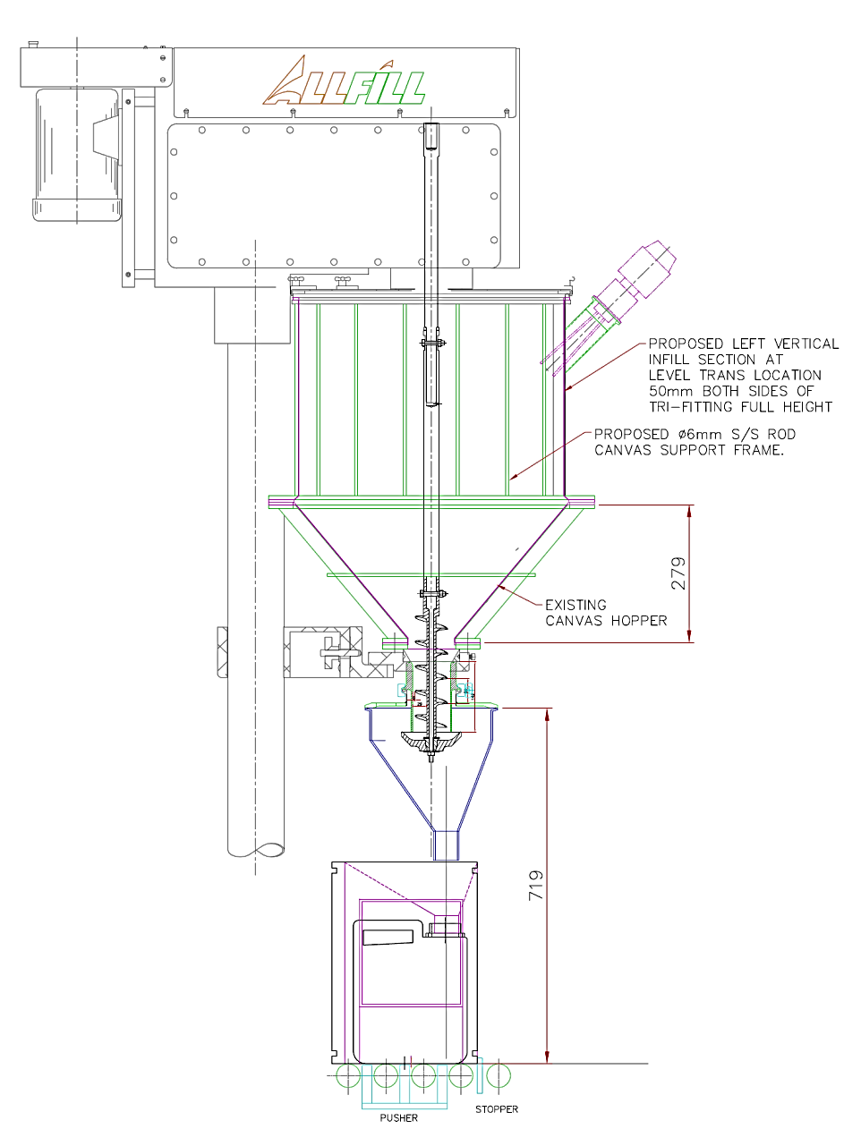
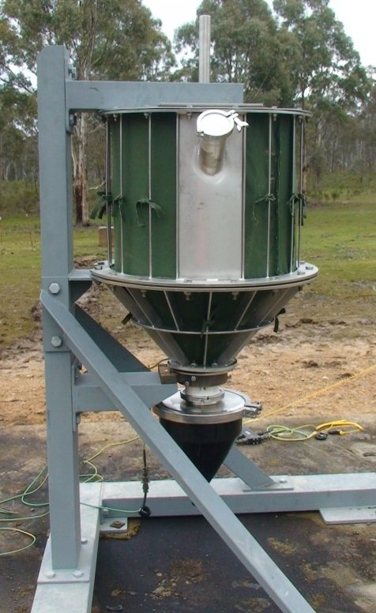
Process Example Propellant Feeder

Slide 33
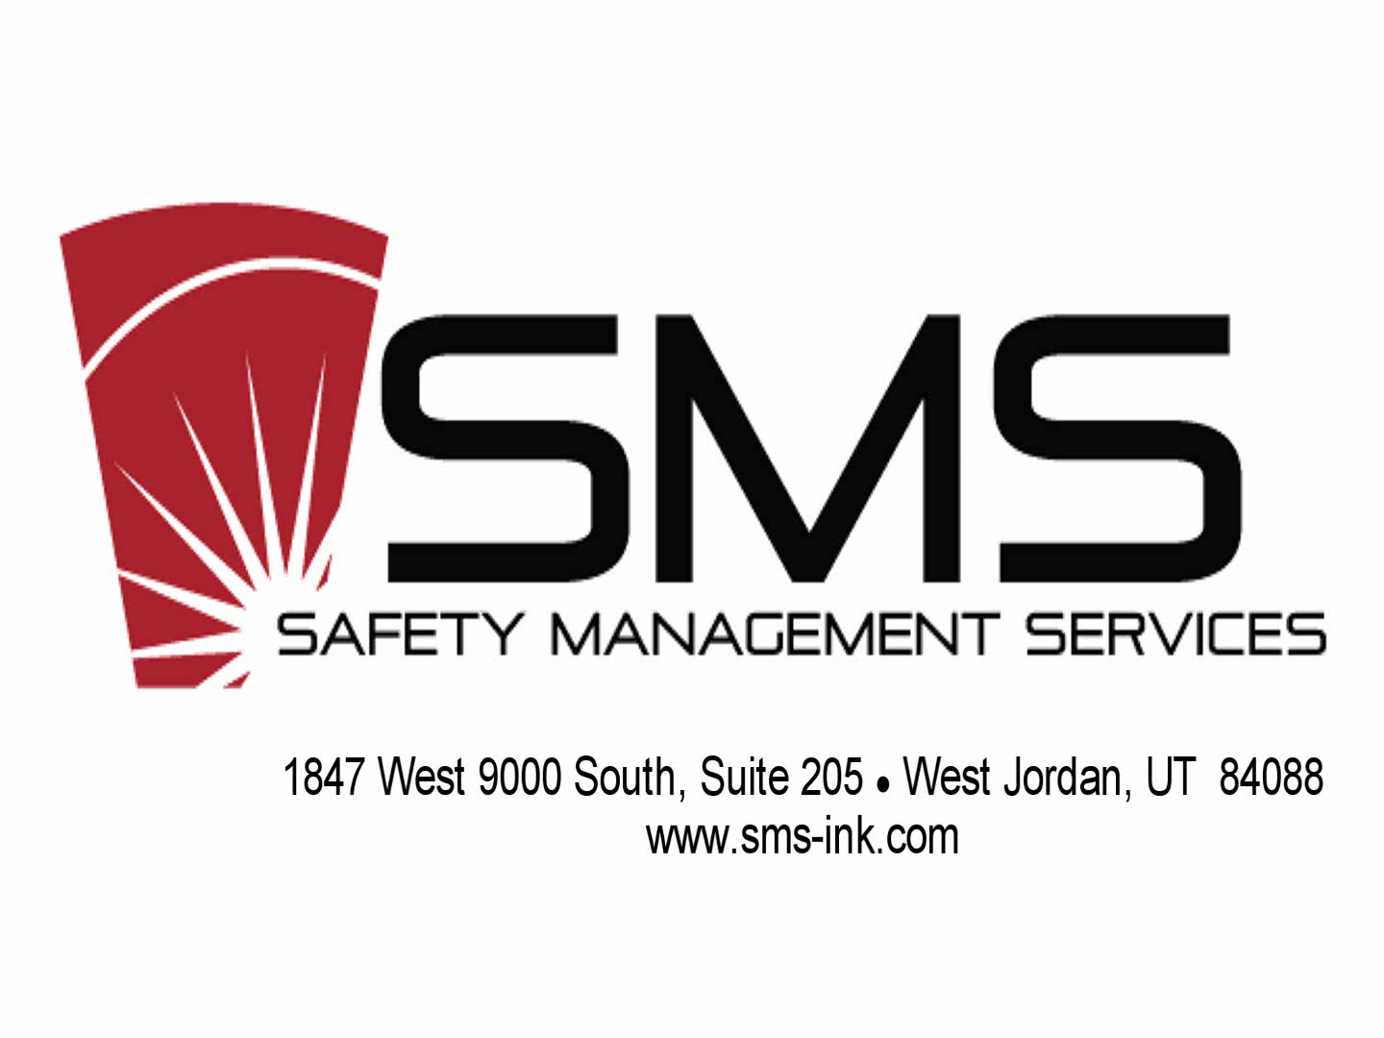
Testing Video Propellant Feeder

Slide 34
Process Example Propellant Feed Hopper
Receiving vessel from glazing ribbon blender
Holds up to 600kg of glazed propellant
Design based on previous testing performed by Australian Munitions on blending hopper
Angle of hopper sides
Size of original canvas vent and feed chute

Slide 35
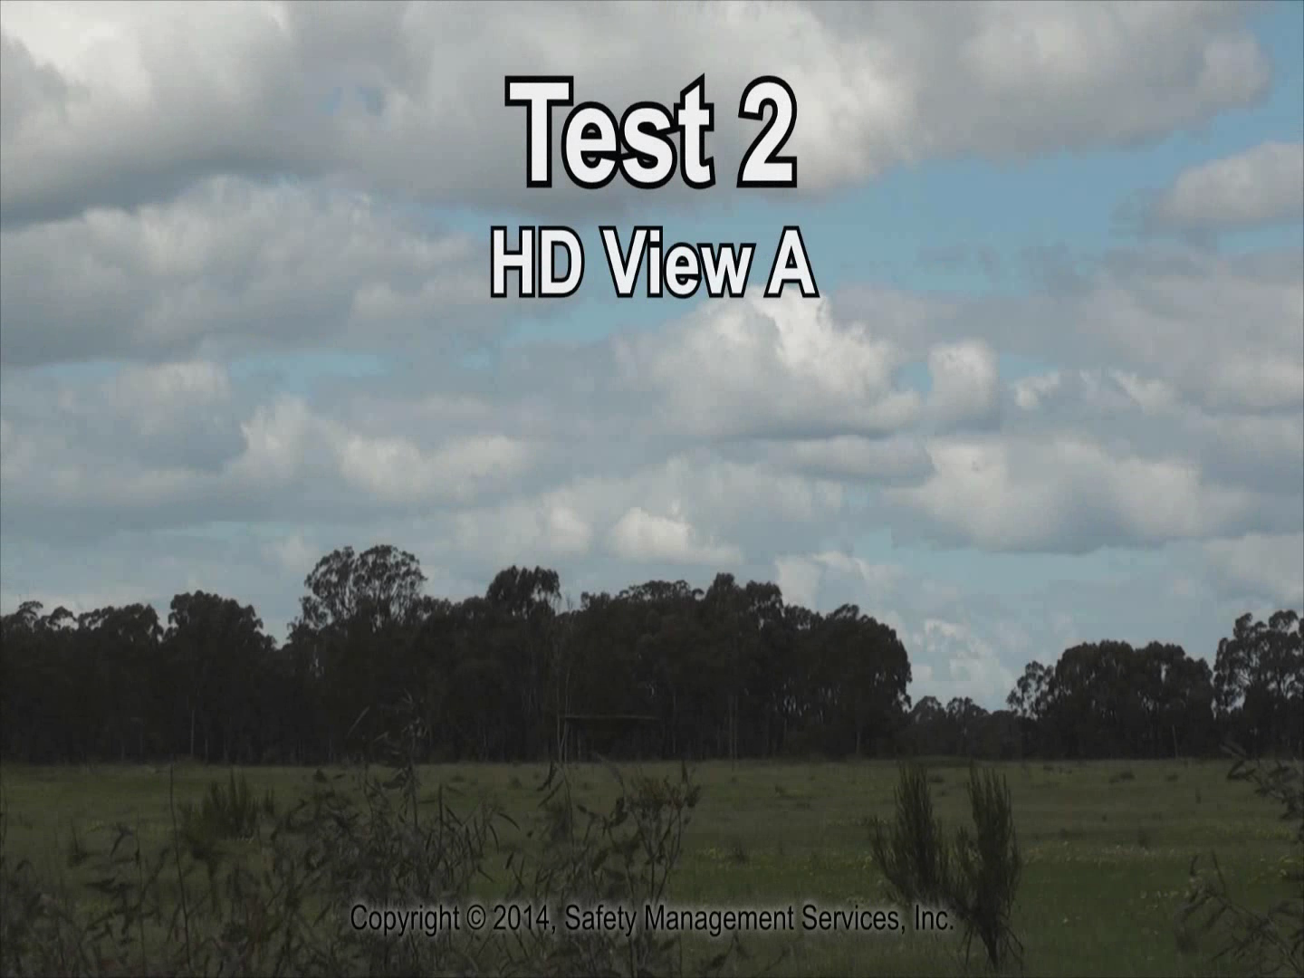
Testing Video Propellant Hopper

Slide 36
SMS Approach:
Systematic Risk Assessment
In-Process Characterization & Classification Testing
Applying Test Data to Minimize Risk

Slide 37
Elements of a Successful Risk Management Program

Slide 38
Summary
Accurate & Systematic Risk Assessment is “KEY” to:
Identifying normal and abnormal process energies and process conditions
Identifying proper sensitivity & reactivity testing and testing parameters
In-Process Sensitivity and Reactivity Testing coupled with Risk Assessment provide proper Design Specifications for:
Process equipment
Control Systems
Facility Siting
Manufacturing Facilities, Barricades, Shielding…

Slide 39
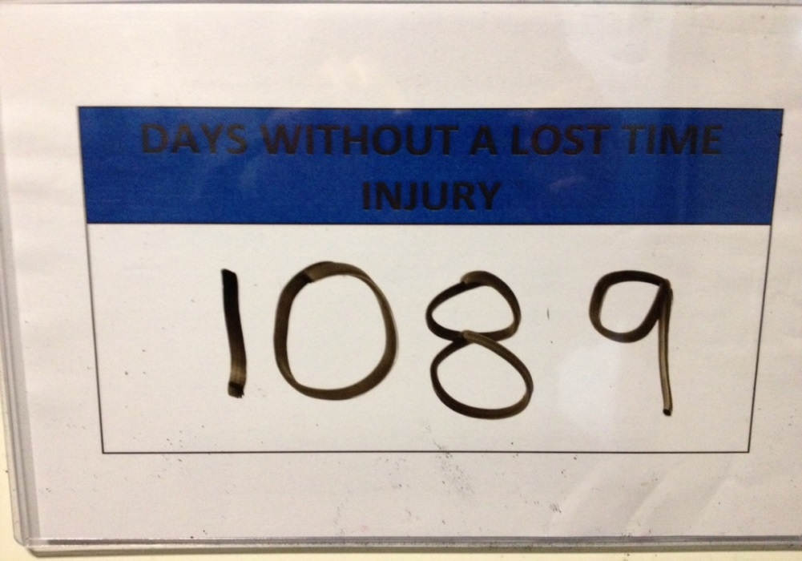
Summary
Systematic Risk Assessment, Testing, and Management Systems Work!
MRP Design, Construction, & Qualification Completed
2.8 Million Man Hours without LTI (1089 Days)
No explosive events

